Slide 2
Call for Abstracts
June 7-10
TOPICs
Important Deadlines
Abstract Submission Deadline
March 20, 2021
* Scholarship & Awards Programs
will be announced on our websites.
Early Bird Registration
Deadline
March 20, 2021
Pre-registration Deadline
April 30, 2021

Slide 3
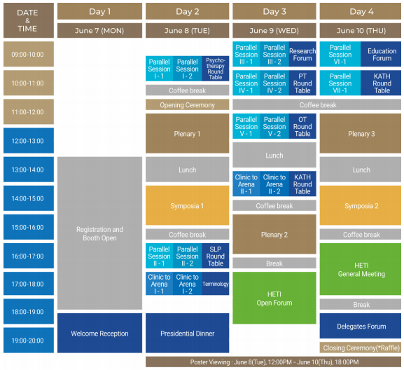
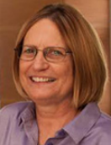
Program at a Glance
June 7-10
4 Days Over 30 sessions
Our Plenary Speakers
Marny Mansfield
State University
of New York
USA
Debbie Silkwood-Sherer
Central Michigan
University
USA
Tracie Faa-Thompson
Turn About Pegasus
UK
Yubal Neria
Columbia University
Medical Center
USA
Janet Jones
Brainworks LLC
USA
Karin Hediger
University of Basel,
Swiss Tropical and
Public Health Institute
Switzerland
* Please visit our website to check more speakers.

Slide 4
Homepage
www.heti2021.org

Slide 5
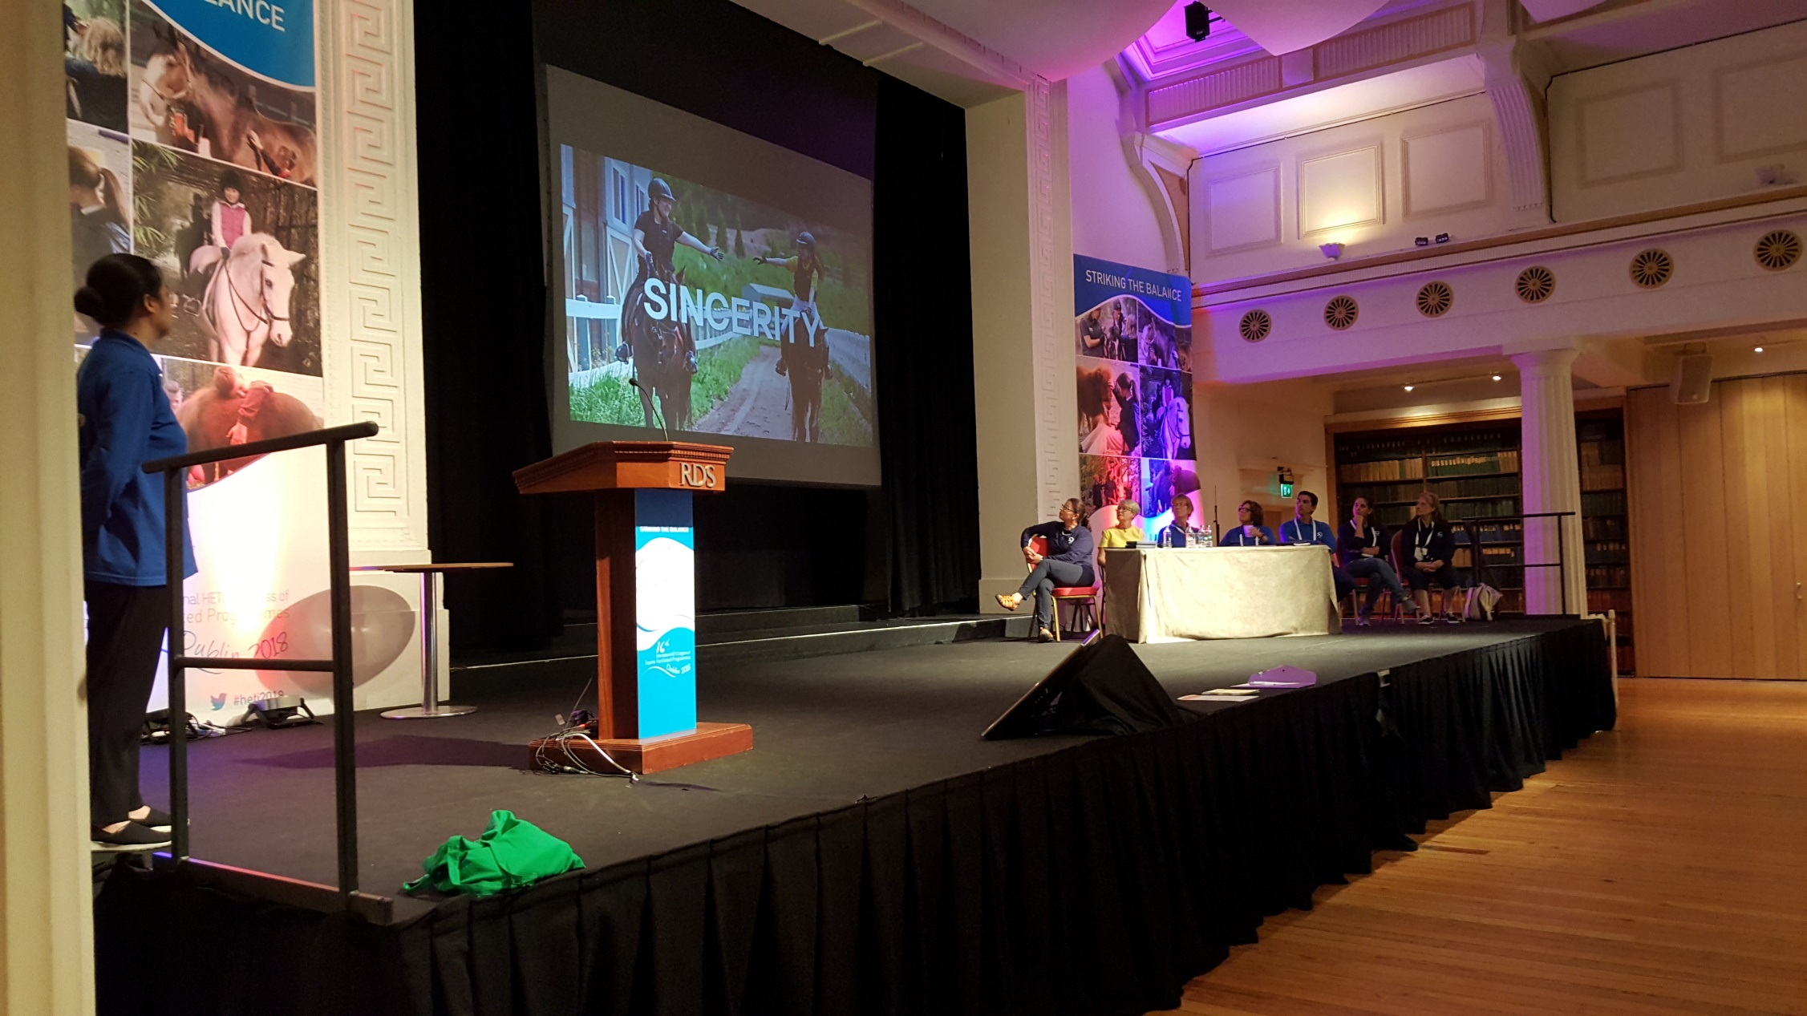
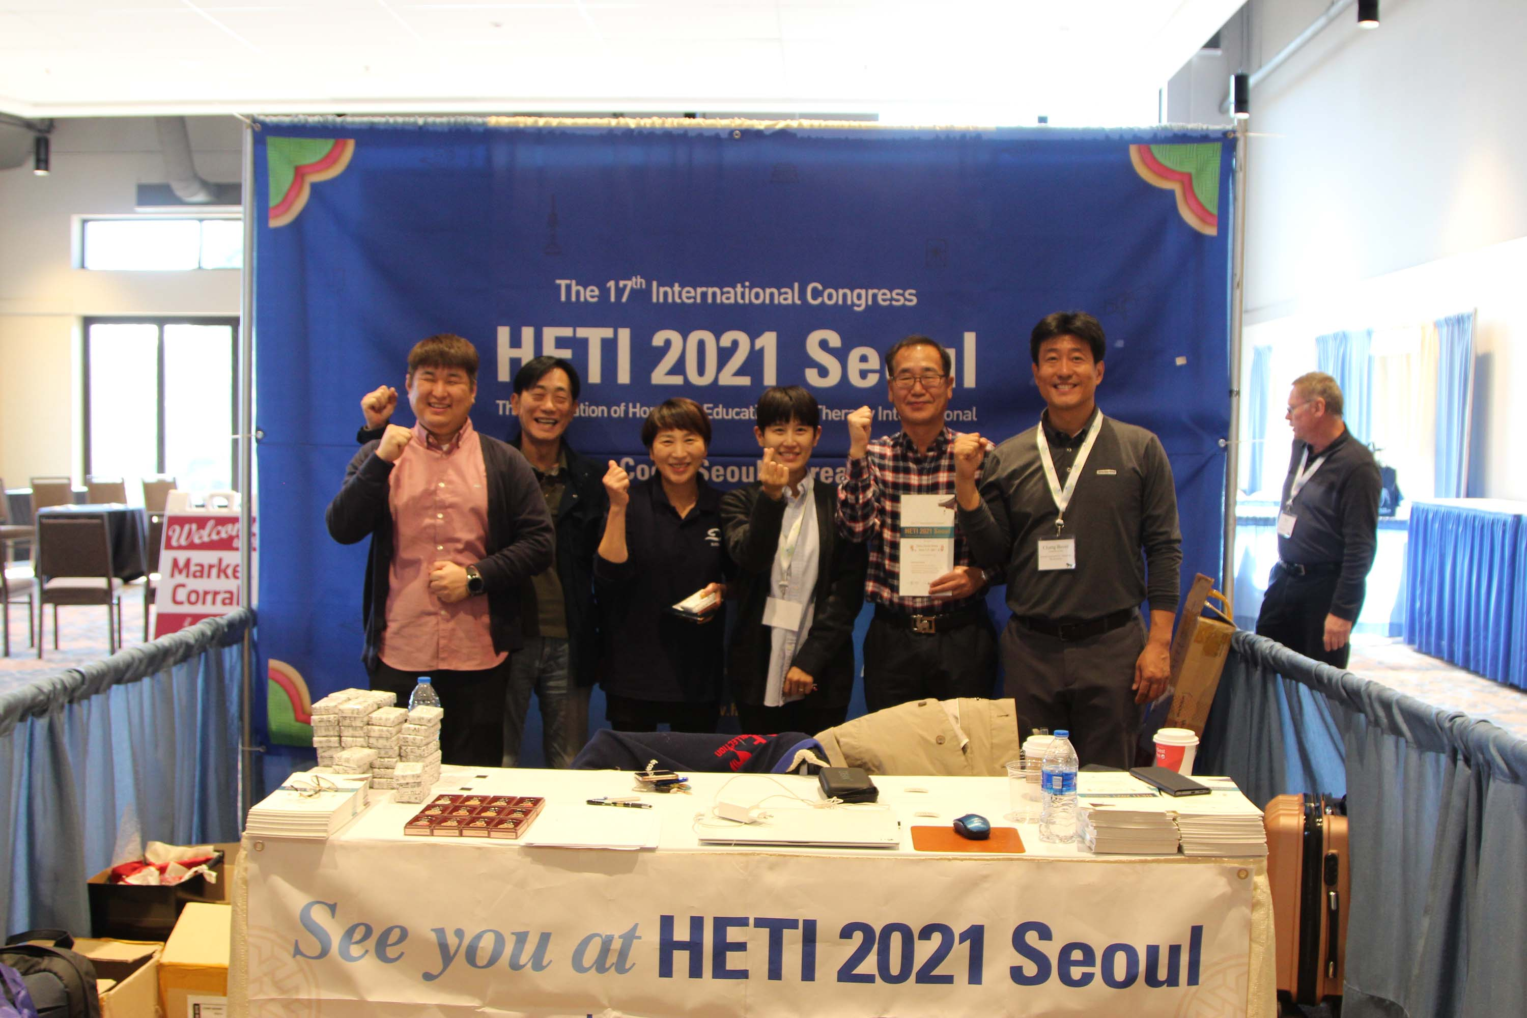
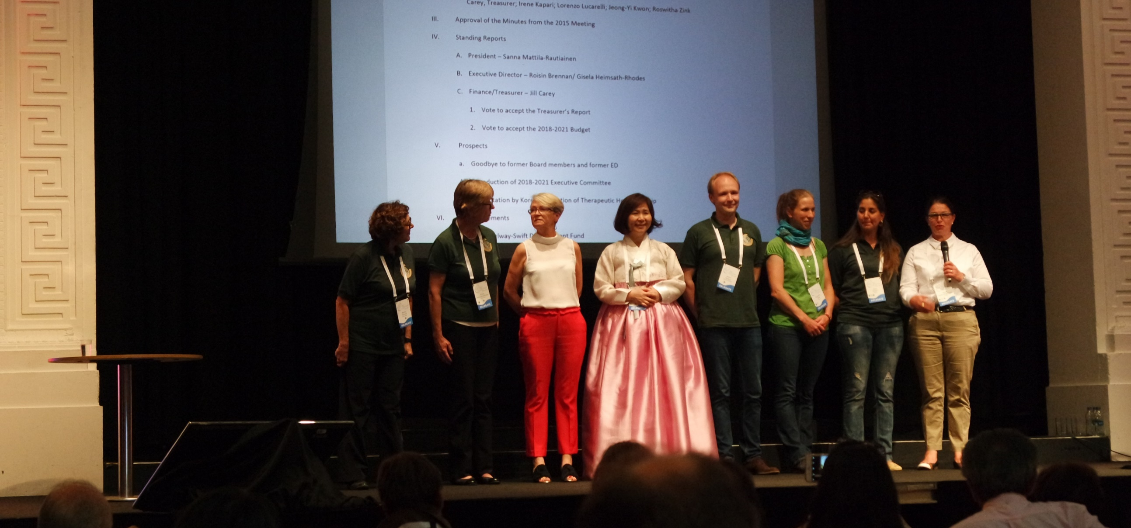
HETI 2021 Promotional Activities

